Slide 1

Module 1: Current Computer Security Landscape
Prepared By:
Prof. Sridhar C Iyer
Assistant Professor
Dept. of Computer Engineering
Dwarkadas J Sanghvi College of Engineering

Slide 2

Introduction
Importance of Cybersecurity
Discusses the critical role that cybersecurity plays in safeguarding computer systems, networks, and data from various threats, emphasizing its significance in the modern digital landscape.
Significance of computer and network security in the digital age.
As digital technology becomes increasingly integrated into everyday life, ensuring the security of computer systems and networks becomes more crucial than ever.

Slide 3

Growing Threats
Escalating volume and sophistication of cyber threats.
Indicates that the number of cyber threats is not only increasing but also becoming more sophisticated, posing greater challenges to security professionals.
Targets: individuals, organizations, and governments.
Identifies that cyber threats are not limited to specific entities; individuals, organizations, and even governments are susceptible to various forms of cyber attacks.

Slide 4

Evolution of Cybersecurity
Emergence of cybersecurity specialists.
Role: Protecting systems from diverse threats.

Slide 5
Changing Landscape
Impact of computerization, digitization, and Internet interconnection.
Evolution in security mechanisms and defense strategies.

Slide 6
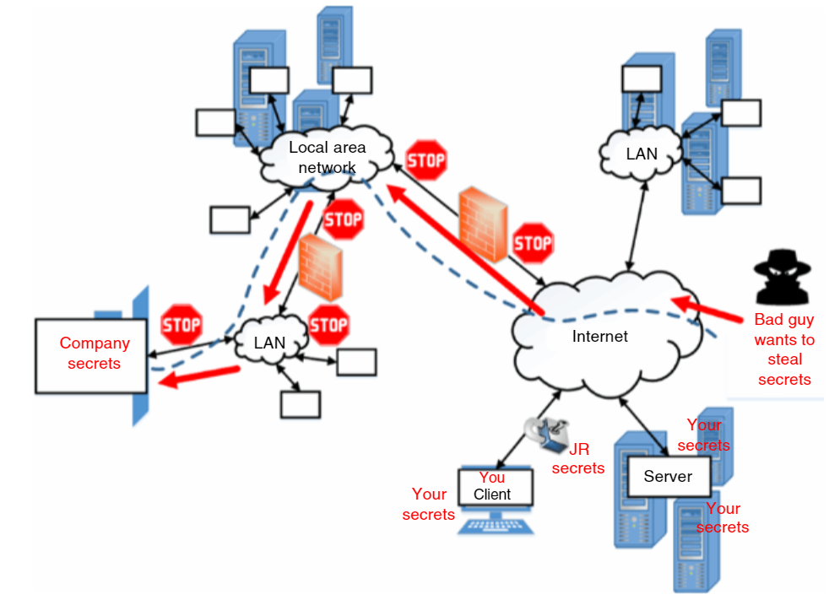
The proliferation of Internet-connected devices in recent decades has surged.
Modern products are designed with high-speed Internet capabilities, generating massive amounts of data that require efficient handling.
Despite the benefits, the evolving landscape has also given rise to more intricate cyber exploits, emphasizing the critical need for robust security measures.

Slide 7
Challenges in Modern Technology
Increasing number of Internet-connected devices.
Complexity of cyber threats.

Slide 8
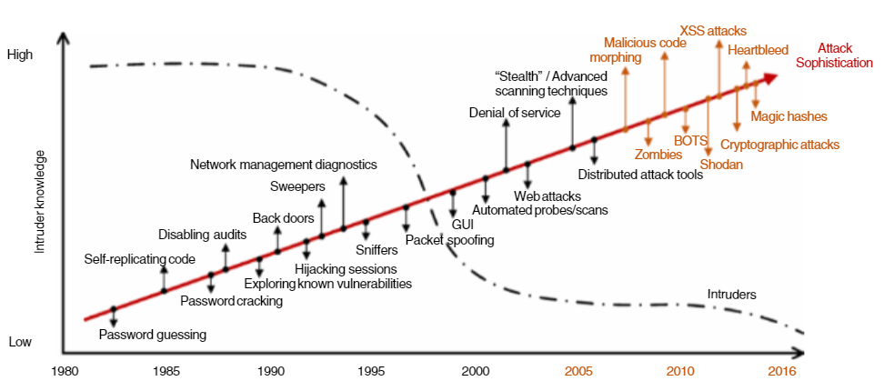

Slide 9
Heartbleed Bug
The Heartbleed Bug is a serious vulnerability in the popular OpenSSL cryptographic software library. This weakness allows stealing the information protected, under normal conditions, by the SSL/TLS encryption used to secure the Internet. SSL/TLS provides communication security and privacy over the Internet for applications such as web, email, instant messaging (IM) and some virtual private networks (VPNs).

Slide 10
Reasons for Growing Cybercrime
Quick adoption of new technologies.
Increased online users from low-income communities.
Financial sophistication of cybercriminals.

Slide 11

Government Initiatives
Enhancing resilience against automated, distributed threats.
Collaborative efforts with international partners.

Slide 12
Some Statistics
Just some recent data. M‐trends (2020) reports that in 2019, Mandiant professionals observed that attacks:
7% originated with or used compromised third‐party access,
15% had multiple attackers,
less than 1% involved an insider,
22% had data theft likely in support of intellectual property or espionage end goals,
29% were likely for direct financial gain including extortion, ransom, card theft, and illicit transfers,
3% of these targeted attacks were for the purpose of reselling access gained in the intrusion,
4% likely served no purpose except for creating compromised architecture to further other attacks.

Slide 13
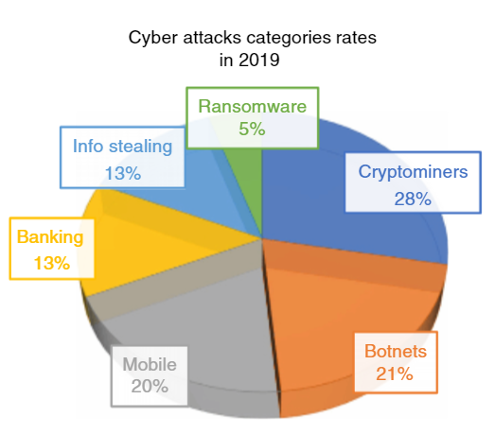

Slide 14
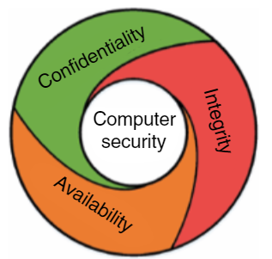
Computer Security Basics
Fundamental Concepts: Confidentiality, Integrity, Availability (CIA).
Protection goals against cyber attacks.

Slide 15
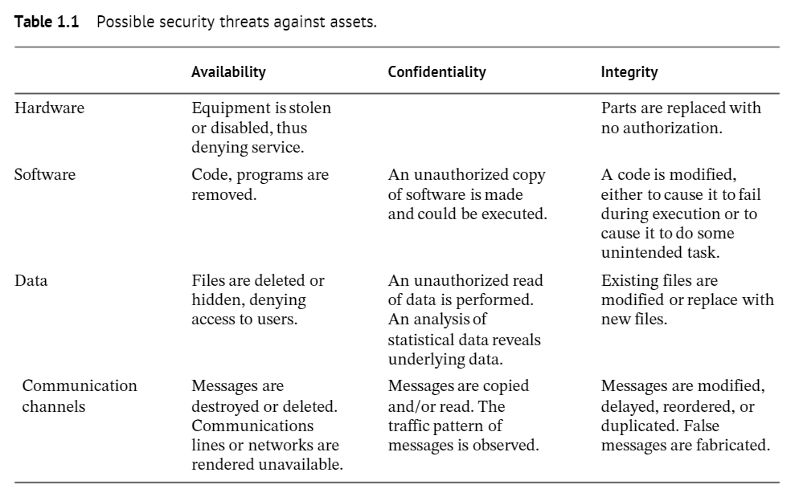

Slide 16
Attack in Computer Security
Definition of an attack in computer security.
Defensive goals to protect against attacks.

Slide 17
Sources of Security Threats
Weaknesses in infrastructure and protocols.
Design and implementation issues.
Vulnerabilities in software.
Hacker activities and social engineering.

Slide 18

Some Case Studies

Slide 19
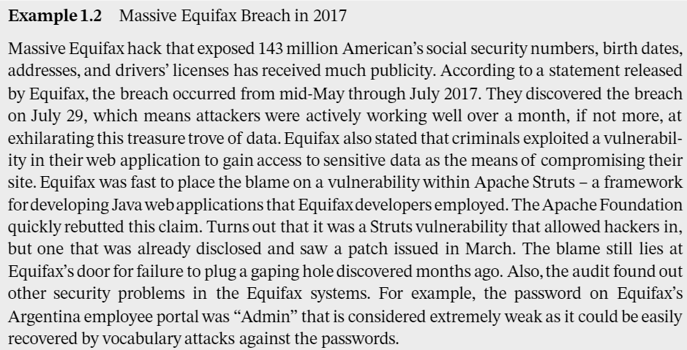
Some Case Studies

Slide 20
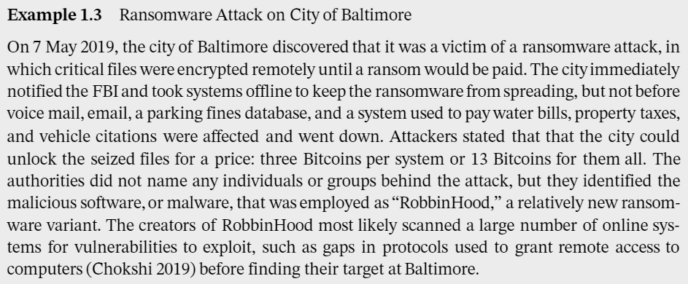
Some Case Studies

Slide 21

Some Case Studies

Slide 22
Physical Security Threats
Ongoing threat of physical theft.
Impact on data security, especially in mobile devices and laptops.

Slide 23
Attacks Against IoT and Wireless Sensor Networks
Overview of attacks on IoT devices.
Need for specialized security measures.

Slide 24
Preliminary and Simple Attacks
Passive Information Gathering.
Traffic and Node Activity Analysis.
Device Subversion by Tampering or Destruction.
Device Malfunctioning.
Cluster Leader or Aggregate Node Outage.

Slide 25
Active Attacks
Sensor Stimuli.
Sybil attack.
False Node and Byzantine Attack
Malicious Message Corruption
Routing Modification and Loops
Sinkhole/Blackhole or Wormhole
Denial of Service
Denial of Sleep
DOS on Sleep
Jamming

Slide 26
Sensor Stimuli Attack
The Sensor Stimuli Attack is a type of active attack on wireless sensor networks (WSN) where the adversary targets the sensed readings to cause resource exhaustion in a particular node. Here's a detailed breakdown of this attack:
1. Prerequisite - Subverted Node:
The attacker needs to compromise or subvert a sensor node within the wireless sensor network.
A subverted node implies that the attacker has gained unauthorized access and control over the compromised node.

Slide 27
Sensor Stimuli Attack (cont.)
2. Execution - Resource Exhaustion:
Once a node is compromised, the attacker exploits it to send repeated requests for sensor readings to the network and other nodes.
The objective is to trigger a high volume of requests, causing excessive utilization of resources in the compromised node.
3. Impact - Node Resource Depletion:
The continuous influx of requests for sensor readings consumes computational resources, memory, and energy of the targeted node.
Over time, this leads to resource exhaustion, potentially rendering the node dysfunctional.

Slide 28
Sensor Stimuli Attack (cont.)
4. Countermeasures:
Access Control and Encryption:
Implement strong access control mechanisms to prevent unauthorized access to sensor nodes.
Use encryption techniques to secure communication within the wireless sensor network, making it difficult for attackers to interfere with sensor readings.
5. Prevention and Mitigation:
Regularly monitor network traffic and behavior to detect unusual patterns that may indicate a Sensor Stimuli Attack.
Employ intrusion detection systems to identify and respond to suspicious activities in real-time.

Slide 29
Sybil Attack
The Sybil Attack is a sophisticated form of attack on wireless sensor networks (WSN) where the adversary attempts to disrupt communication and compromise the integrity of the network. Here's a detailed breakdown of the Sybil Attack:
1. Execution - Node Cloning:
The attacker creates multiple illegitimate nodes, known as Sybil nodes, to clone and impersonate genuine nodes within the network.
Each Sybil node appears as a distinct entity, potentially overwhelming the network with fake identities.

Slide 30
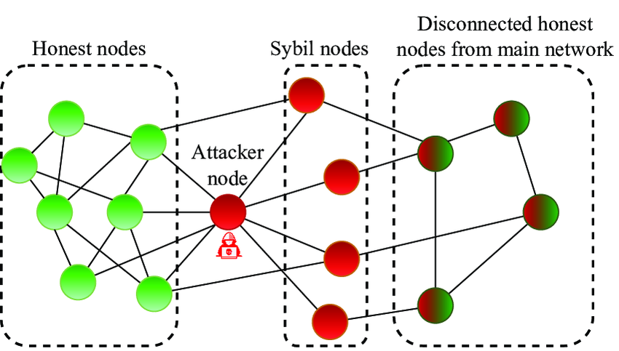

Slide 31
Sybil Attack (cont.)
2. Strategy - Routing Table Manipulation:
The Sybil nodes attempt to manipulate routing information within the network.
By corrupting or disrupting the routing tables of legitimate nodes, the attacker can control the flow of traffic and cause congestion or disruption.
3. Impact - Congestion and Disruption:
The compromised routing information leads to congestion and disruption of both control and actual information flow within the network.
Legitimate nodes may receive false information or be unable to establish proper communication due to the presence of Sybil nodes.

Slide 32
Sybil Attack (cont.)
Prevention and Detection:
Regularly monitor the network for anomalies in traffic patterns or deviations from expected behavior.
Employ intrusion detection systems capable of identifying patterns indicative of Sybil Attacks.

Slide 33

Byzantine Attack
A False Node Attack, also known as a Byzantine Attack, is a type of malicious activity in a distributed network where a compromised node intentionally behaves incorrectly or maliciously to disrupt the normal functioning of the network. Here's an in-depth look at the characteristics and implications of a False Node (Byzantine) Attack:
Byzantine Generals Problem:
The term "Byzantine" is derived from the Byzantine Generals Problem, a theoretical scenario where a group of generals must coordinate their actions to attack or retreat but may have traitorous members providing conflicting information.
In the context of distributed networks, a False Node Attack mirrors this problem, with a compromised node disseminating false or conflicting information.

Slide 34
Byzantine Attack (cont.)
Objective - Network Disruption:
The primary objective of a False Node Attack is to disrupt the normal operation of the distributed network.
By spreading misinformation or conflicting messages, the attacker aims to create confusion, compromise consensus, or cause the network to make incorrect decisions.
Multiple Compromised Nodes:
Unlike a Sybil Attack where multiple fake nodes are created, a False Node Attack may involve only one or a few compromised nodes within the network.
These nodes act in concert to deceive the network and compromise its integrity.

Slide 35
Byzantine Attack (cont.)
Countermeasures:
Byzantine Fault Tolerance (BFT):
Implement BFT protocols that enable the network to withstand the malicious behavior of a certain percentage of nodes.
BFT mechanisms involve redundancy and voting schemes to identify and exclude malicious nodes.
Cryptographic Techniques:
Use cryptographic methods to secure communication between nodes and ensure the integrity and authenticity of messages.
Digital signatures and secure communication channels can help in verifying the legitimacy of nodes.

Slide 36

Sinkhole/ Wormhole Attack
A Sinkhole/Wormhole Attack is a type of security threat in computer networks, particularly in wireless ad-hoc and sensor networks. This attack involves the malicious redirection of network traffic to a centralized point (sinkhole) or a tunnel (wormhole), allowing an attacker to compromise the network's integrity. Here's a detailed explanation of the Sinkhole/Wormhole Attack:
Sinkhole Attack:
In a Sinkhole Attack, the attacker attracts and diverts network traffic towards a central point, known as the sinkhole.
The sinkhole is typically a malicious node or a compromised entity that intercepts and controls the communication flow.

Slide 37

Sinkhole/ Wormhole Attack
Wormhole Attack:
In a Wormhole Attack, the attacker establishes a covert communication tunnel (wormhole) between two distant points in the network.
This tunnel allows the attacker to relay packets from one end to the other, making it appear as if the communication is direct, while, in reality, it is being manipulated.

Slide 38

Sinkhole/ Wormhole Attack
Objective - Misdirection and Manipulation:
The primary goal of both Sinkhole and Wormhole Attacks is to misdirect and manipulate network traffic.
By controlling the flow of data, the attacker can eavesdrop on sensitive information, inject malicious packets, or disrupt the normal communication between network nodes.

Slide 39
Sinkhole/Wormhole Attack
Countermeasures:
Secure Routing Protocols:
Implement routing protocols that are resistant to attacks and can detect anomalies in the network topology.
Secure and authenticated routing can help prevent nodes from being misled by false routing information.
Intrusion Detection Systems (IDS):
Deploy IDS to monitor network behavior and detect unusual patterns indicative of a Sinkhole or Wormhole Attack.
Anomaly detection techniques can identify deviations from normal communication patterns.
Cryptographic Solutions:
Use cryptographic techniques to secure communication channels and data integrity.
Authentication mechanisms can ensure that nodes can trust each other, reducing the risk of falling victim to malicious redirection.

Slide 40

Introduction to Artificial Intelligence (AI)
Brief overview of artificial intelligence.

Slide 41
Why AI is needed in Computer Security?
The volume of available data, the velocity of its generation, the variety of various data sources and the data veracity and quality problem scale move cyber security out of the human abilities range.
Unfortunately, this discrepancy between cyber security problems, sophistication, volume and variety on one hand and the human operator qualification to address them on another is expected to grow up even much more.
Analysing and improving cyber security posture is not a human scale problem anymore. Cyber criminals and hackers have realised it and have been already widely utilising intelligent techniques and technologies.
Cyber security professionals, in order not to lose in the competition, have to employ intelligent technologies too. Fortunately, they have had already gained a lot of experience in design and application of intelligence systems, in enhancing network security, recognising attacks, discovering security vulnerabilities and differentiating legitimate users from hackers.
In cyber security practice most of the existing tools employ AI in one form or another however those applications remain more or less hidden.

Slide 42
Definition of AI
Various AI definitions do exist. Even ISO (the International Organization for Standardization) attempted to provide 2 definitions as:
An interdisciplinary field, usually regarded as a branch of computer science, dealing with models and systems for the performance of functions generally associated with human intelligence, such as reasoning and learning.
The capability of a functional unit to perform functions that are generally associated with human intelligence, such as reasoning and learning.

Slide 43
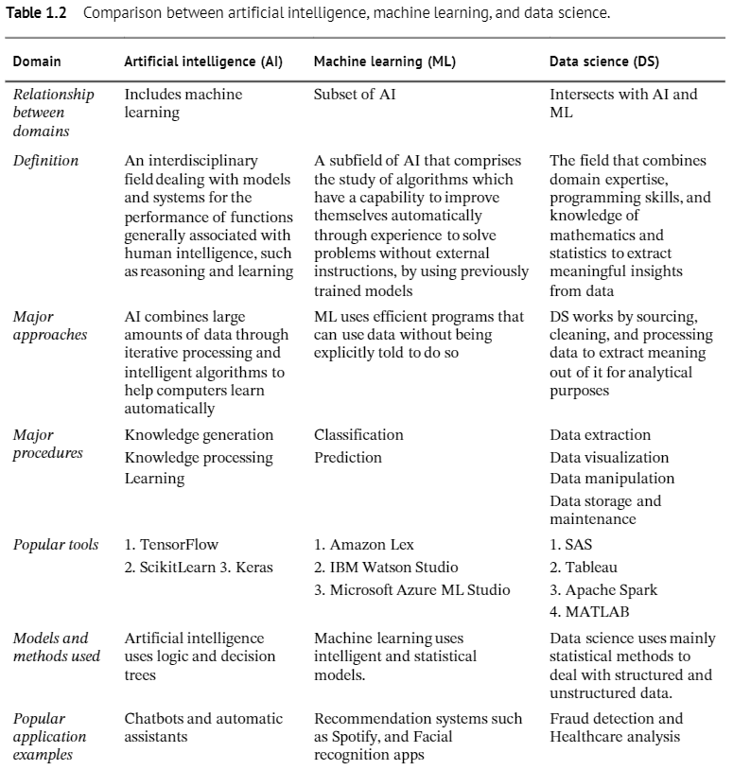
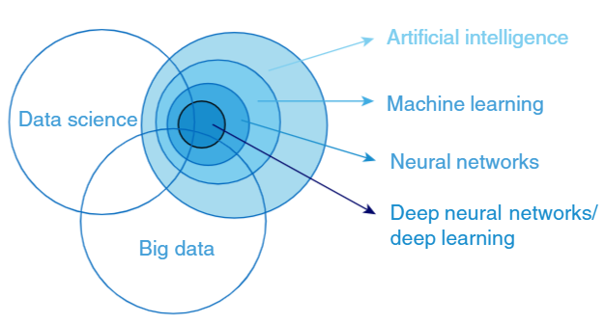

Slide 44
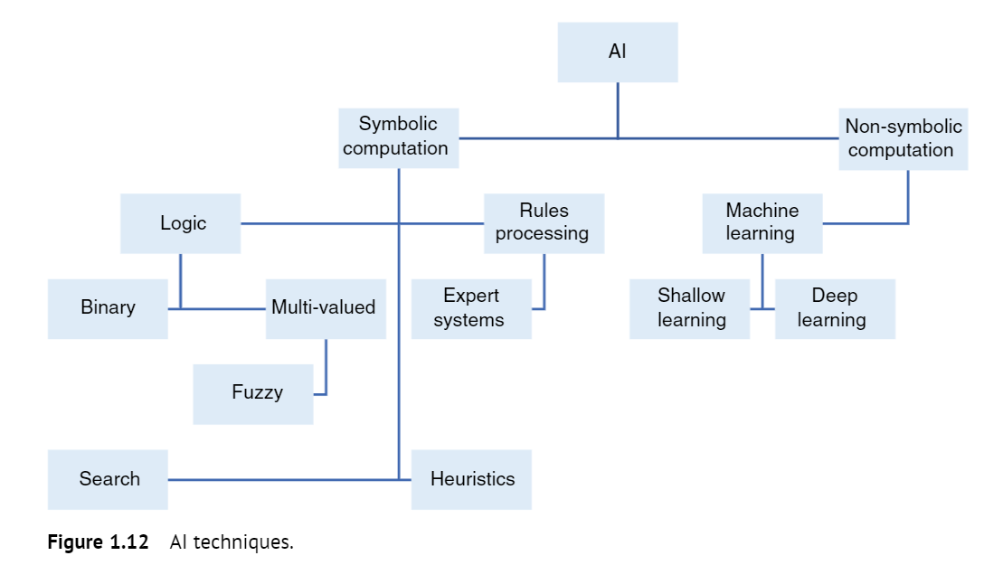

Slide 45
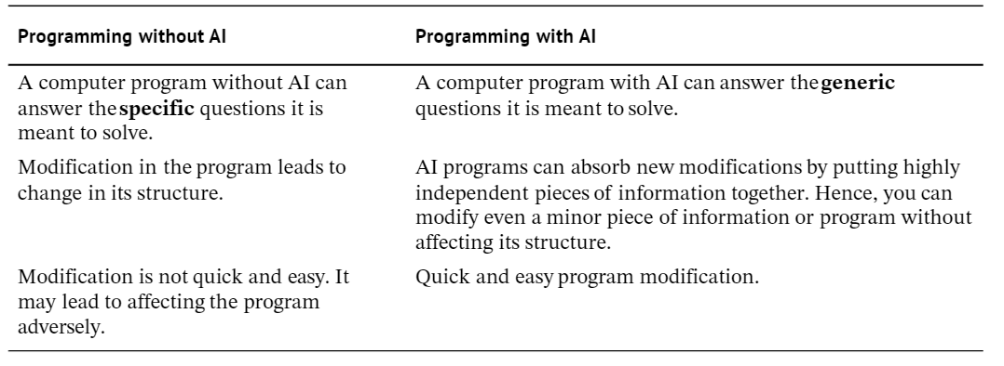
Conventional vs AI Approaches to Coding

Slide 46
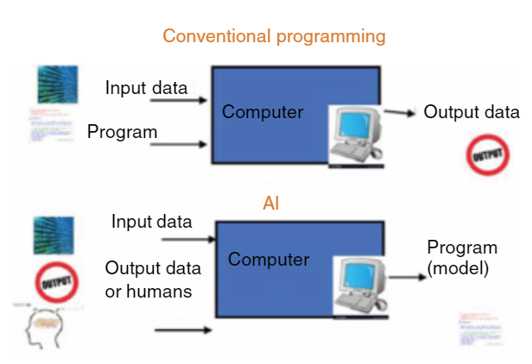

Slide 47
Rules Based vs Expert Systems
Rules-Based Systems:
A rules-based system is a type of software that uses a set of predefined rules to make decisions or perform actions. These rules are typically expressed in the form of "if-then" statements, where certain conditions trigger specific actions. Rules-based systems are widely used in various domains for decision support and automation.
Expert Systems:
An expert system is a type of artificial intelligence (AI) system designed to emulate the decision-making ability of a human expert in a specific domain. It uses a knowledge base of facts and heuristics to draw inferences and make decisions. Expert systems are particularly valuable in situations where human expertise is critical but may not be readily available.

Slide 48
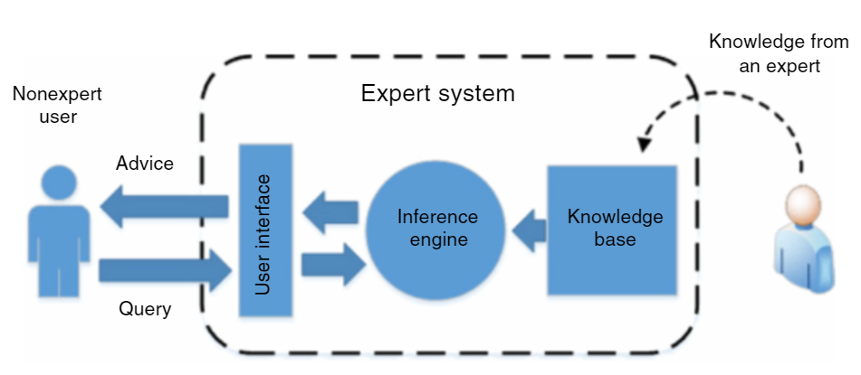
An Expert System Composition and Operation

Slide 49
The basic structure of an expert system consists of the following parts.
The knowledge base of rules.
The database of facts,
the inference engine,
the interpreter,
and the human computer interaction interface.
The knowledge base is used to store an expert system expertise, including the database of facts and the rules employed to process them with the inference engine. It should be able to acquire new knowledge, expressing and storing knowledge in a way that the computer can accomplish.
The inference engine matches the facts in the database with the rules from the knowledge base and derives new information which is placed back in the database.
The explanation facilities are responsible for interpreting the results of the inference engine output. Including explaining the correctness and reason of the conclusion to the user. That is done through a specialised user interface.

Slide 50
The knowledge base consists of rules, the term rule in AI which is the most commonly used type of knowledge representation can be defined as an IF-THEN structure that relates, given information or facts in the IF Part to some action in the THEN part.
A rule provides some description of how to solve a problem.
Rules are relatively easy to create an understand.
Any rule consists of 2 parts. The IF Part called the antecedent and the THEN part called the consequent. It has the following generic format.
IF antecedent THEN consequent.

Slide 51
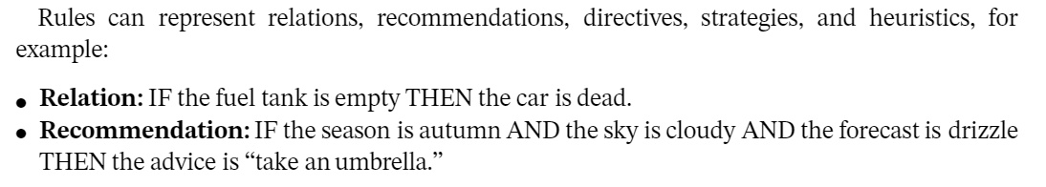
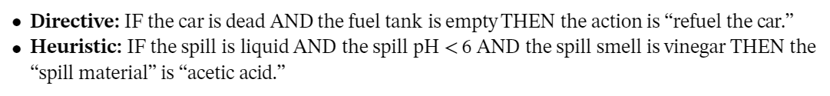
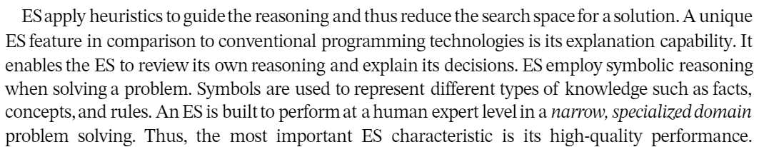

Slide 52
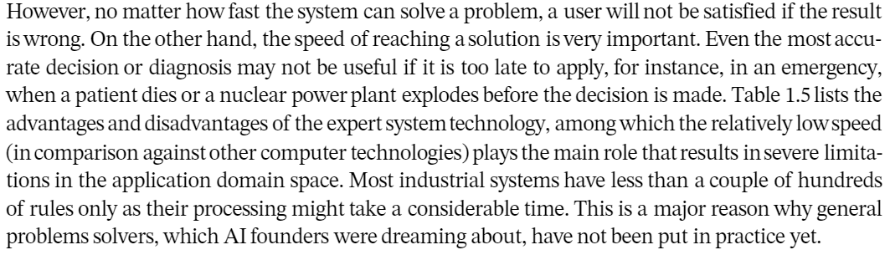

Slide 53
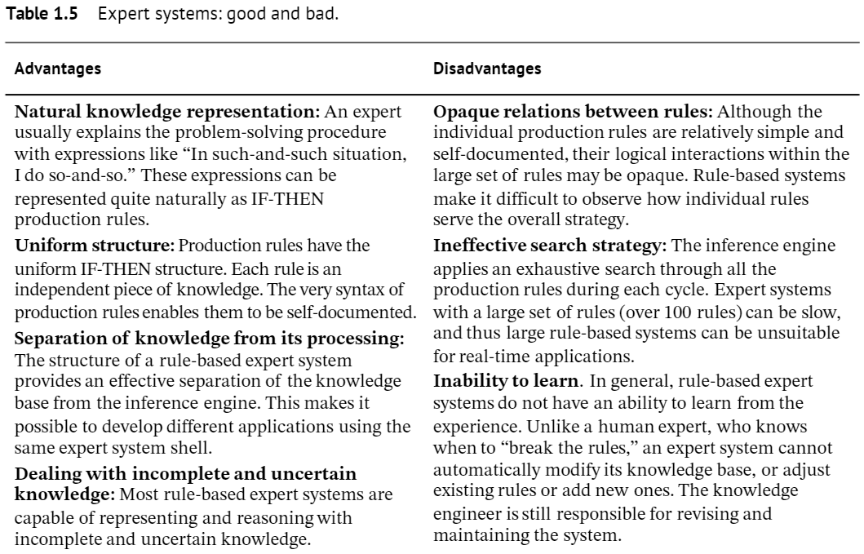

Slide 54
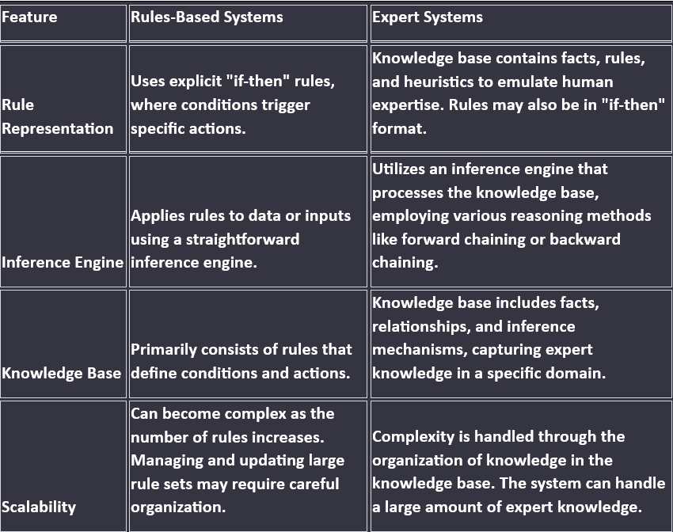

Slide 55
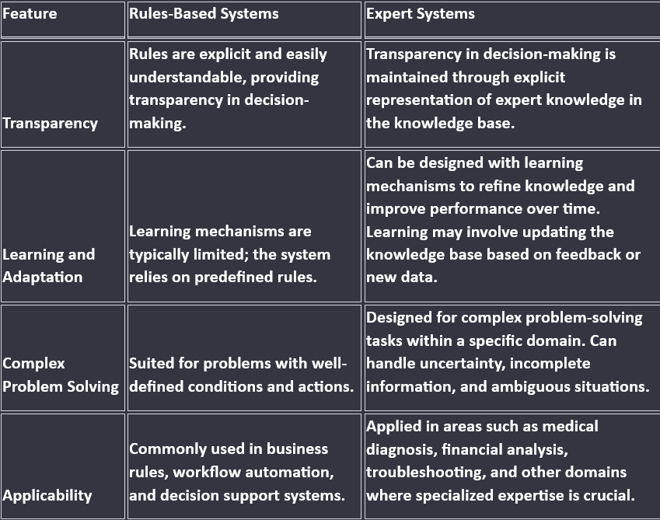

Slide 56
Humans Vs Expert Systems Vs Conventional Programming Approaches
Human, Expert System, and Conventional Programming approaches are three different ways to solve problems or perform tasks, each with its own characteristics and applications. Here's a comparison of these approaches:
Nature of Decision-Making:
Human: Relies on human intuition, experience, and cognitive abilities to make decisions.
Expert System: Uses predefined rules and knowledge base to make decisions, mimicking human expertise.
Conventional Programming: Follows a set of predetermined instructions to make decisions.
Knowledge Representation:
Human: Knowledge is acquired through experience, learning, and intuition.
Expert System: Knowledge is explicitly represented in a knowledge base using rules, facts, and inference mechanisms.
Conventional Programming: Knowledge is encoded in the form of algorithms and data structures.

Slide 57
3. Flexibility and Adaptability:
Human: Adaptable to new and unforeseen situations, can learn and adjust based on experience.
Expert System: Relatively rigid, may struggle with unforeseen situations unless explicitly programmed for them.
Conventional Programming: Lacks flexibility, requires code modification for adapting to new scenarios.
4. Problem-solving Approach:
Human: Holistic and adaptable approach, able to handle complex and ambiguous situations.
Expert System: Rule-based reasoning and pattern recognition, suited for well-defined problems within a specific domain.
Conventional Programming: Algorithmic approach, suitable for problems with well-defined logic and clear step-by-step solutions.
5. Learning Capability:
Human: Constantly learning and adapting through experience.
Expert System: Limited learning ability, typically requires human intervention to update knowledge.
Conventional Programming: Static and does not inherently learn from data or experience.

Slide 58
6. Domain of Application:
Human: Universal applicability across a wide range of domains.
Expert System: Specific to a well-defined domain where expertise can be codified.
Conventional Programming: General-purpose and applicable to a wide variety of tasks.
7. Development Time and Effort:
Human: High development time, but adaptable and capable of handling diverse tasks.
Expert System: Initial development time may be high, but once developed, it can provide consistent performance.
Conventional Programming: Moderate to high development time, depending on the complexity of the problem.
8. Debugging and Maintenance:
Human: Adaptable to changing conditions but may be prone to errors and biases.
Expert System: Debugging and maintenance are relatively easier compared to conventional programming, as changes can often be made in the knowledge base.
Conventional Programming: Debugging and maintenance can be complex, especially for large systems.

Slide 59
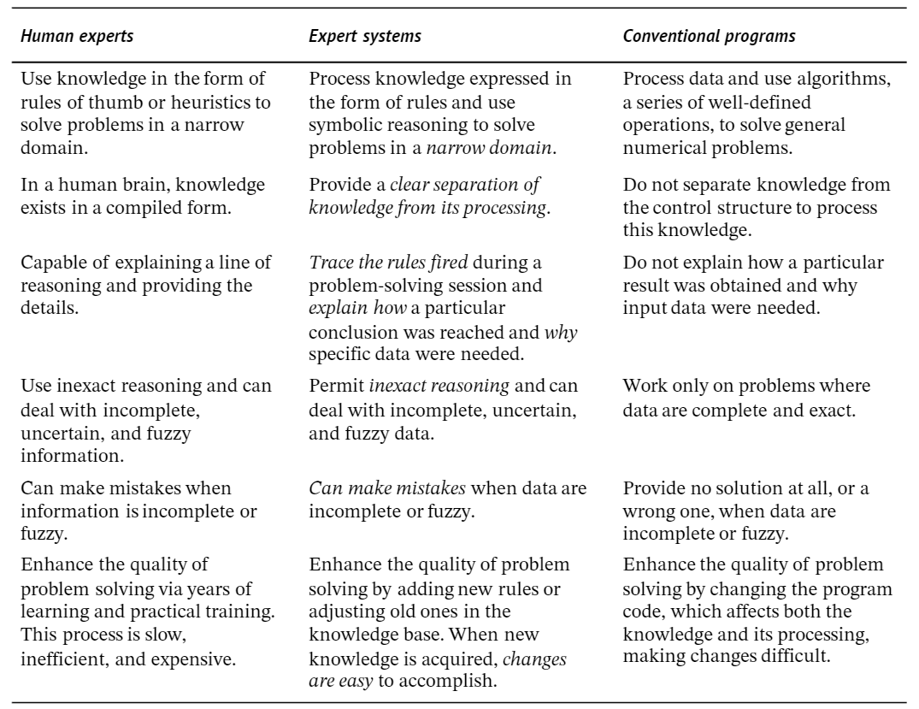

Slide 60
Fuzzy Logic

Slide 61
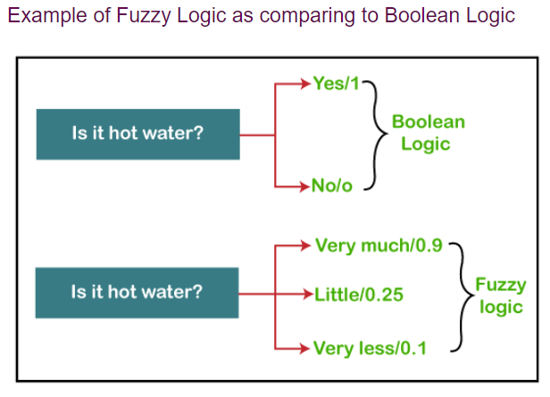
The 'Fuzzy' word means the things that are not clear or are vague. Sometimes, we cannot decide in real life that the given problem or statement is either true or false. At that time, this concept provides many values between the true and false and gives the flexibility to find the best solution to that problem.
Fuzzy logic contains multiple logical values and these values are the truth values of a variable or problem between 0 and 1.
This concept was introduced by Lofti Zadeh in 1965 based on the Fuzzy Set Theory. This concept provides the possibilities which are not given by computers, but similar to the range of possibilities generated by humans.
In the Boolean system, only two possibilities (0 and 1) exist, where 1 denotes the absolute truth value and 0 denotes the absolute false value. But in the fuzzy system, there are multiple possibilities present between the 0 and 1, which are partially false and partially true.
The Fuzzy logic can be implemented in systems such as micro-controllers, workstation-based or large network-based systems for achieving the definite output. It can also be implemented in both hardware or software.

Slide 62
Characteristics of Fuzzy Logic
Following are the characteristics of fuzzy logic:
This concept is flexible and we can easily understand and implement it.
It is used for helping the minimization of the logics created by the human.
It is the best method for finding the solution of those problems which are suitable for approximate or uncertain reasoning.
It always offers two values, which denote the two possible solutions for a problem and statement.
It allows users to build or create the functions which are non-linear of arbitrary complexity.
In fuzzy logic, everything is a matter of degree.
In the Fuzzy logic, any system which is logical can be easily fuzzified.
It is based on natural language processing.
It is also used by the quantitative analysts for improving their algorithm's execution.
It also allows users to integrate with the programming.

Slide 63
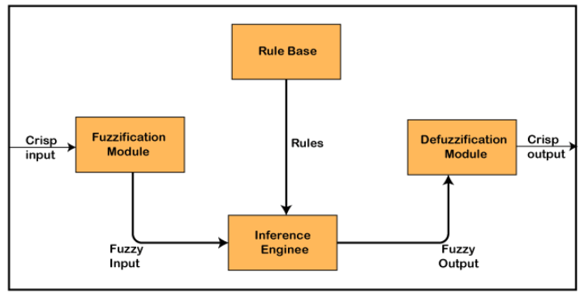
Architecture of a Fuzzy Logic System
In the architecture of the Fuzzy Logic system, each component plays an important role. The architecture consists of the different four components which are given below.
Rule Base
Fuzzification
Inference Engine
Defuzzification

Slide 64
1. Rule Base
Rule Base is a component used for storing the set of rules and the If-Then conditions given by the experts are used for controlling the decision-making systems. There are so many updates that come in the Fuzzy theory recently, which offers effective methods for designing and tuning of fuzzy controllers. These updates or developments decreases the number of fuzzy set of rules.
2. Fuzzification
Fuzzification is a module or component for transforming the system inputs, i.e., it converts the crisp number into fuzzy steps. The crisp numbers are those inputs which are measured by the sensors and then fuzzification passed them into the control systems for further processing. This component divides the input signals into following five states in any Fuzzy Logic system:
Large Positive (LP)
Medium Positive (MP)
Small (S)
Medium Negative (MN)
Large negative (LN)

Slide 65
3. Inference Engine
This component is a main component in any Fuzzy Logic system (FLS), because all the information is processed in the Inference Engine. It allows users to find the matching degree between the current fuzzy input and the rules. After the matching degree, this system determines which rule is to be added according to the given input field. When all rules are fired, then they are combined for developing the control actions.
4. Defuzzification
Defuzzification is a module or component, which takes the fuzzy set inputs generated by the Inference Engine, and then transforms them into a crisp value. It is the last step in the process of a fuzzy logic system. The crisp value is a type of value which is acceptable by the user. Various techniques are present to do this, but the user has to select the best one for reducing the errors.

Slide 66
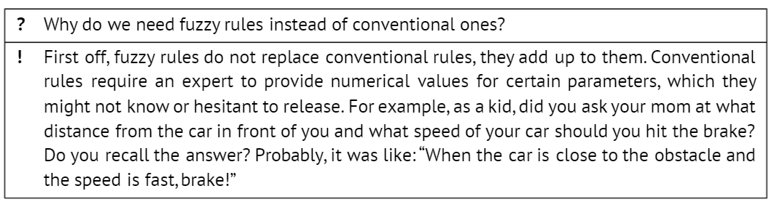
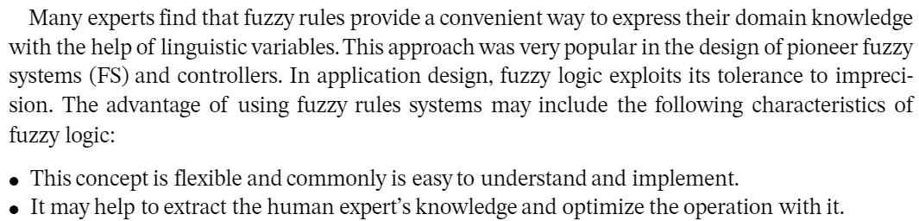
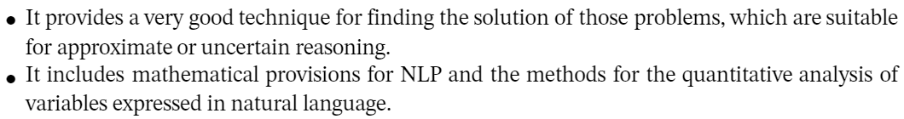

Slide 67
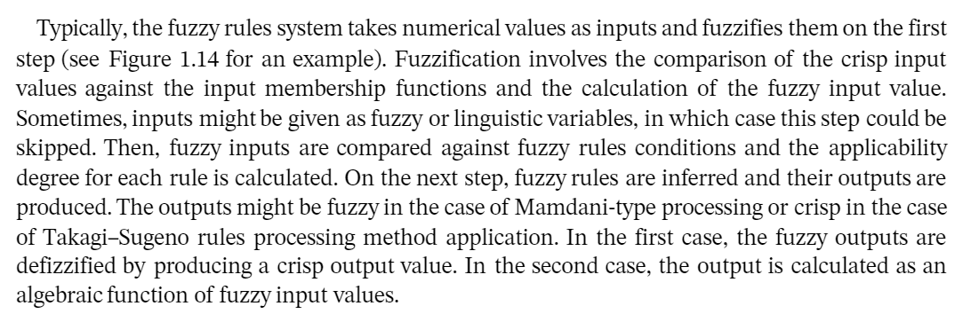
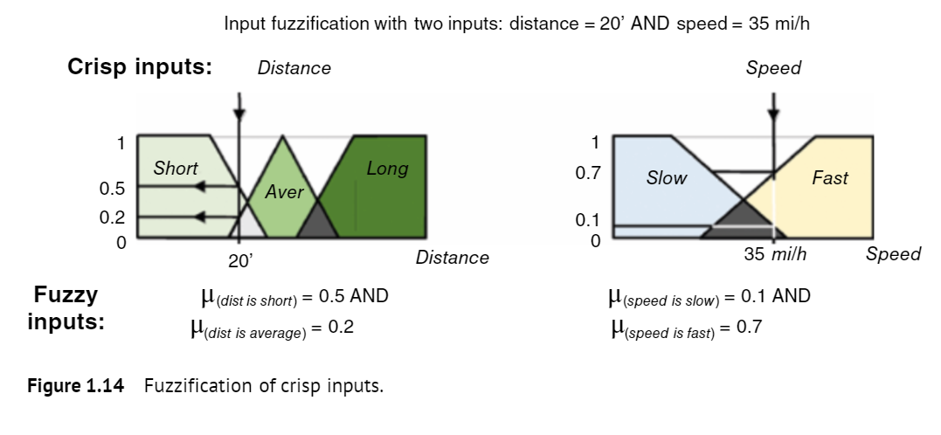

Slide 68
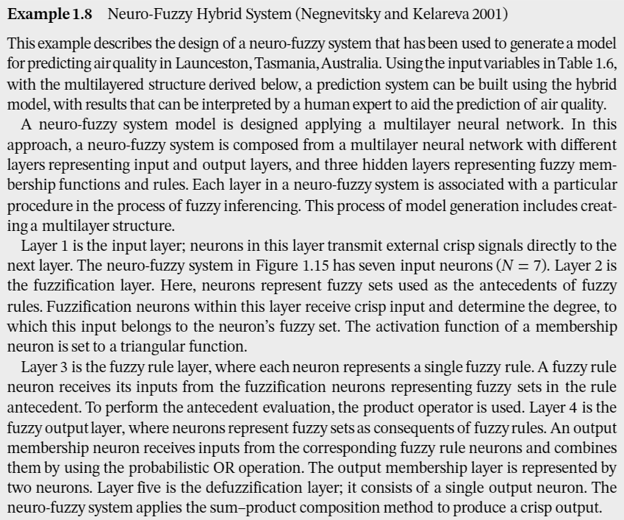
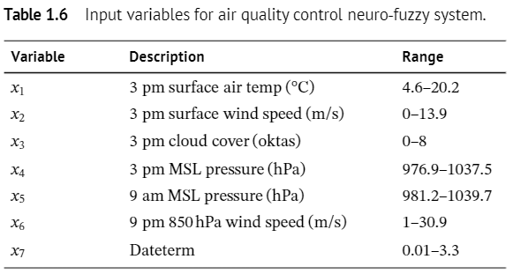

Slide 69
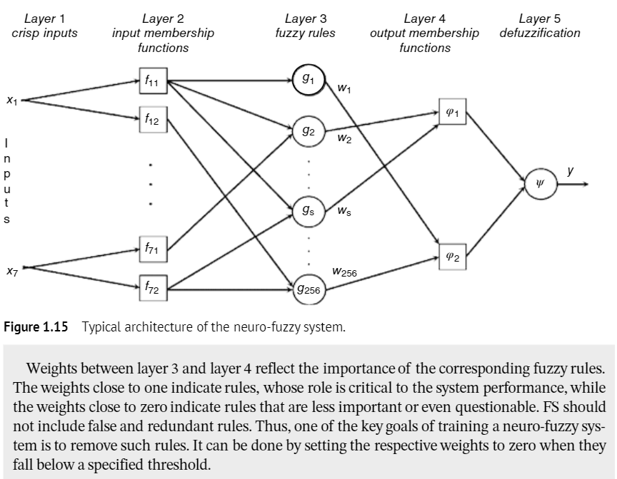

Slide 70
Machine Learning and Data Science
Contribution of machine learning and data science to cybersecurity.

Slide 71
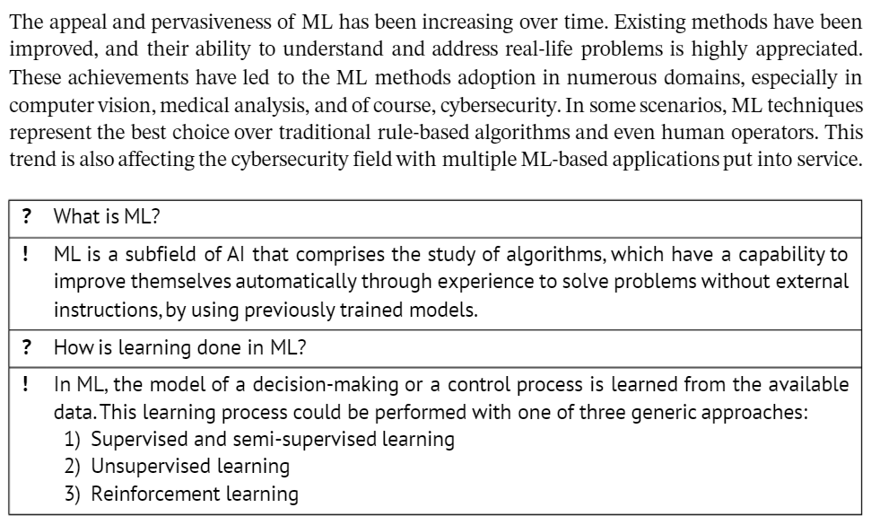

Slide 72
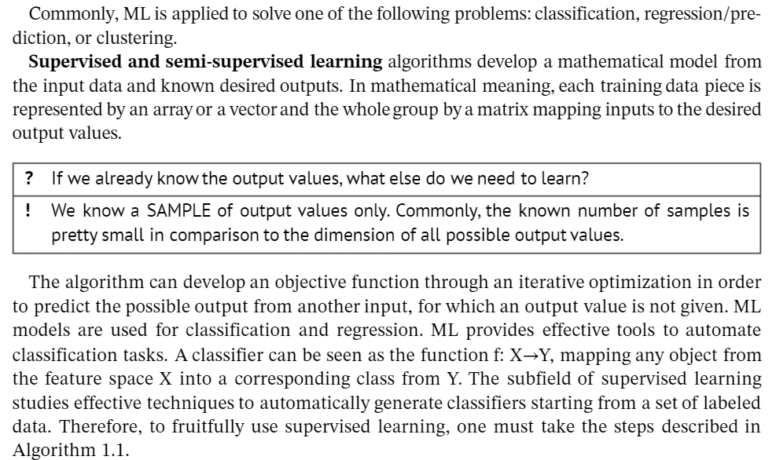

Slide 73
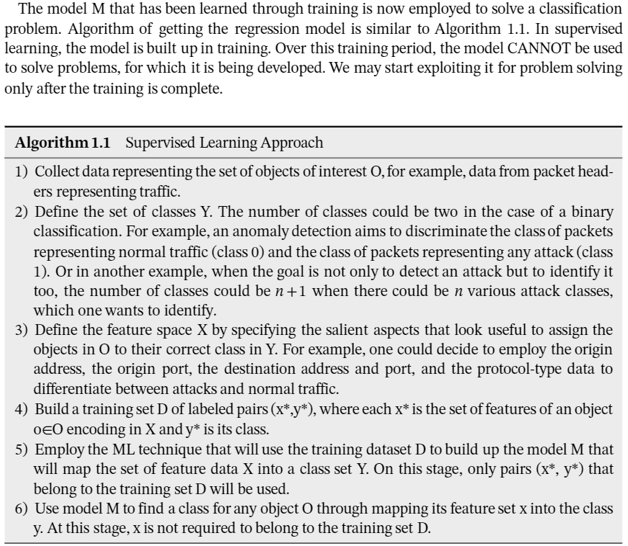

Slide 74
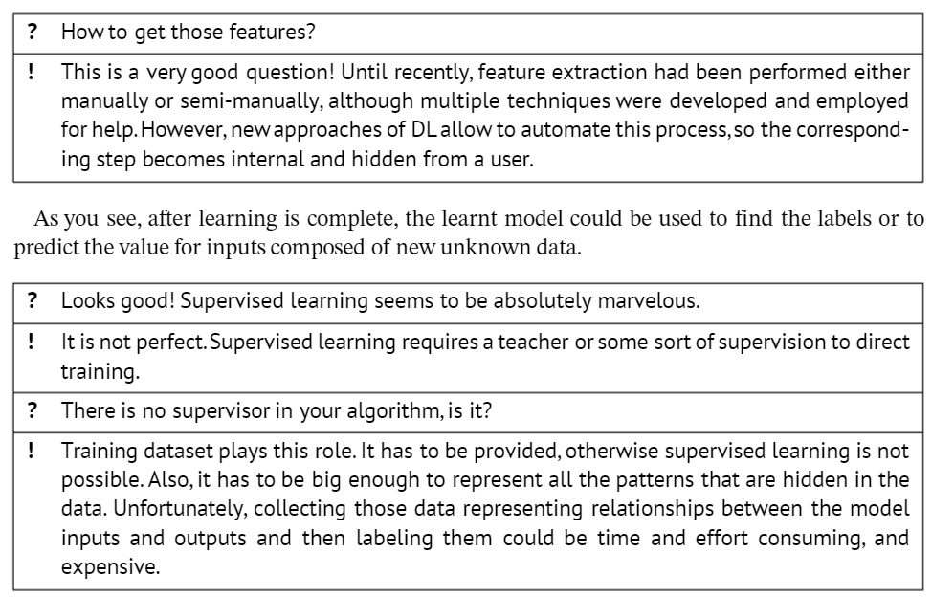
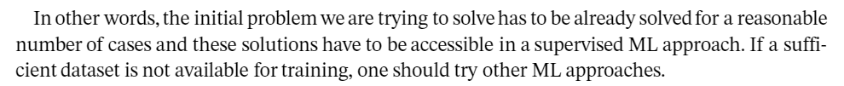

Slide 75
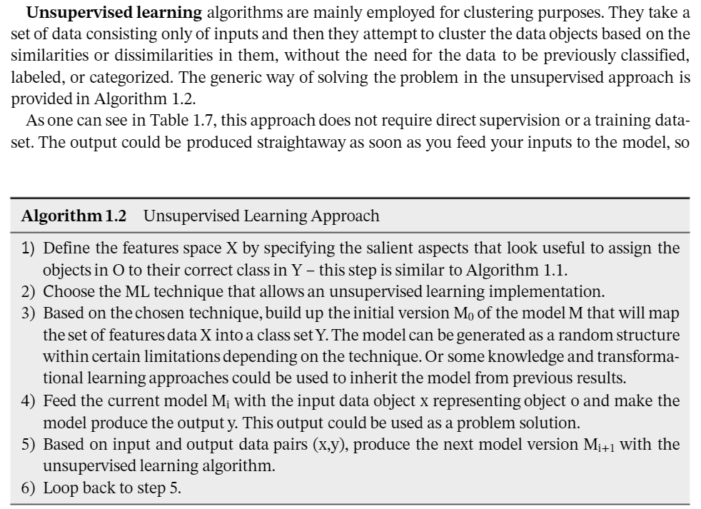

Slide 76
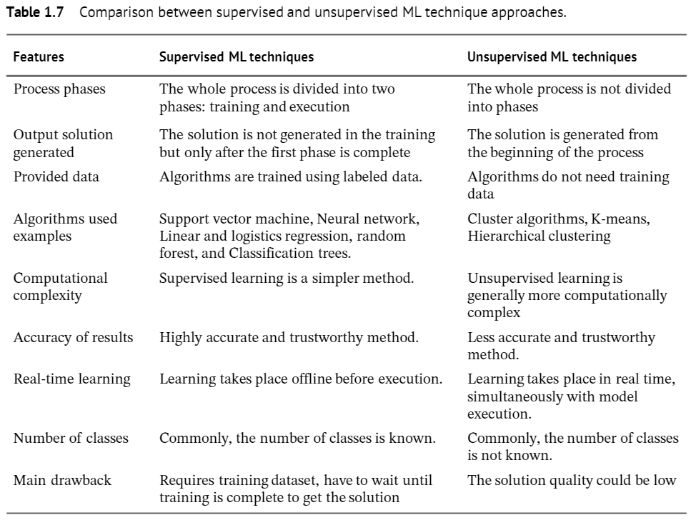

Slide 77
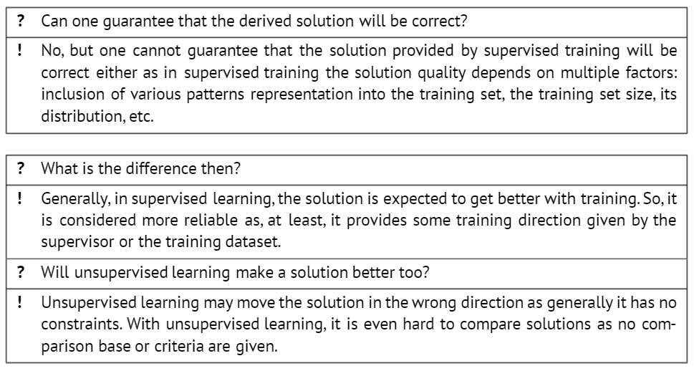
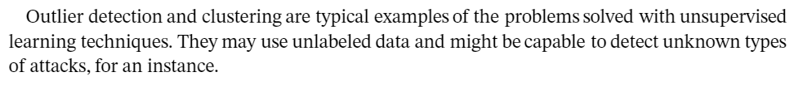

Slide 78
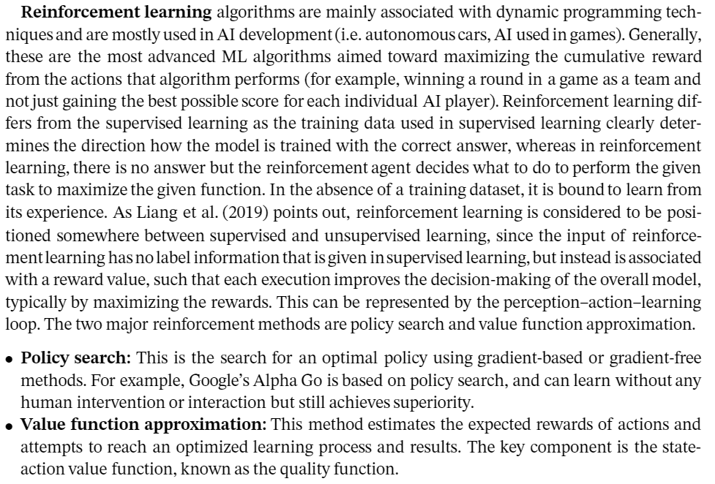

Slide 79
ML In Cybersecurity
Contribution of machine learning and data science to cybersecurity.

Slide 80
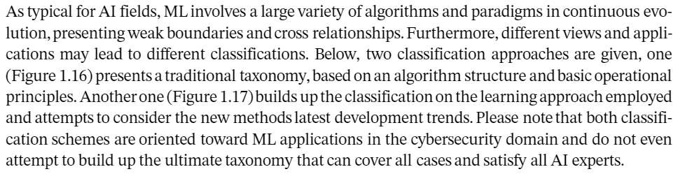

Slide 81
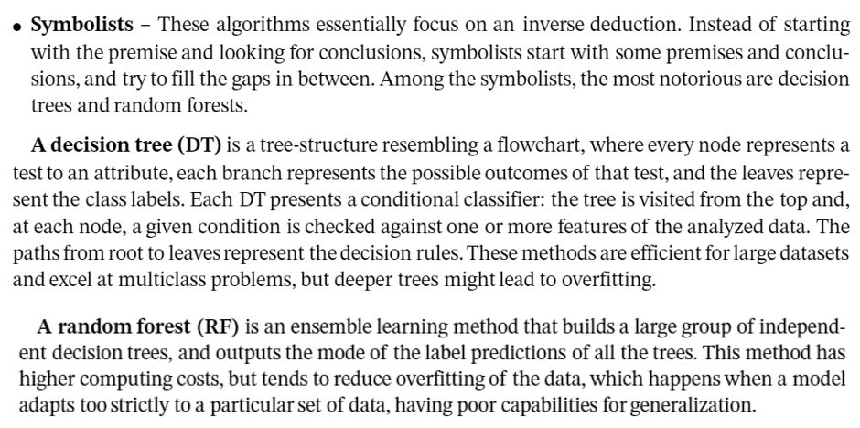

Slide 82
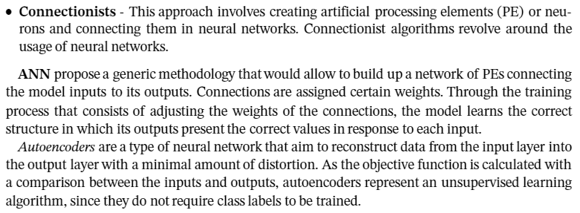

Slide 83
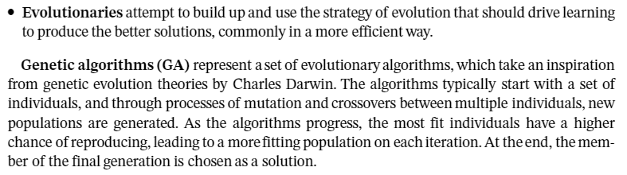
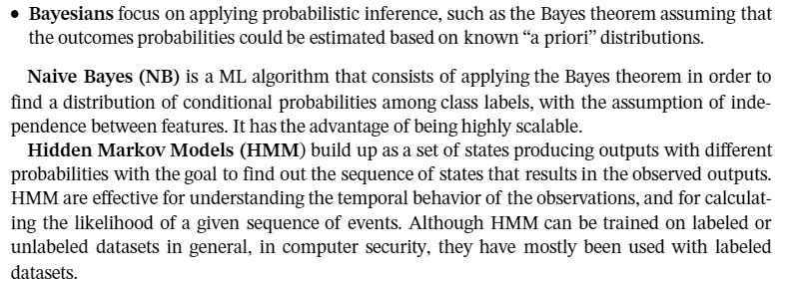

Slide 84
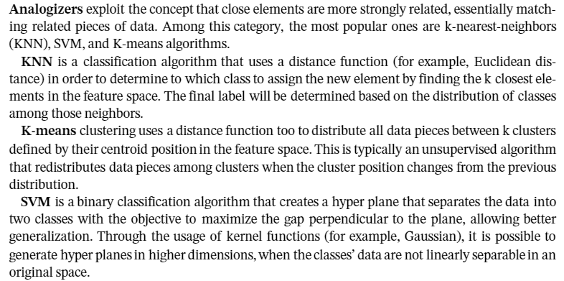

Slide 85
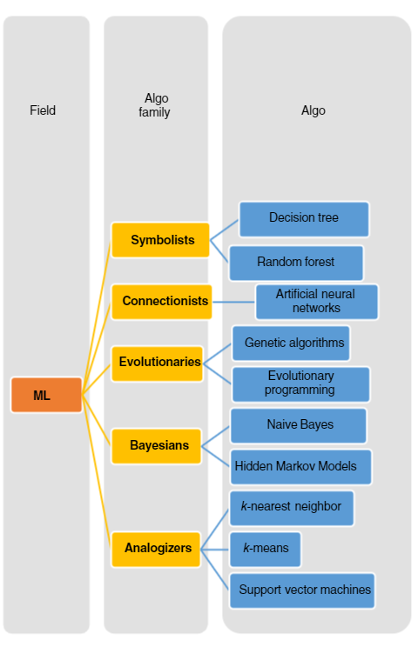
Fig 1.16: ML Algorithm Families and
Classification

Slide 86
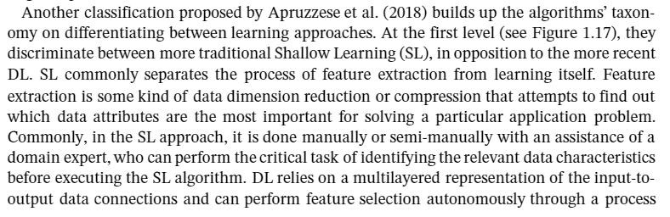

Slide 87


Slide 88


Slide 89
Artificial Neural Networks

Slide 90


Slide 91


Slide 92


Slide 93



Slide 94


Slide 95


Slide 96



Slide 97



Slide 98



Slide 99


Slide 100



Slide 101



Slide 102


Slide 103


Slide 104


Slide 105


Slide 106
Genetic Algorithms

Slide 107



Slide 108



